Slide 1
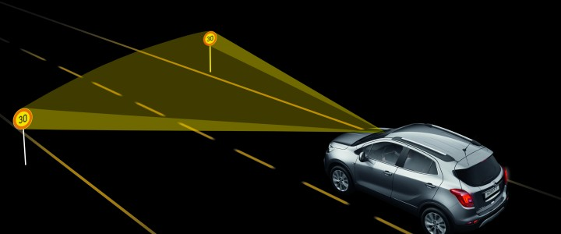
Traffic Sign Recognition
Presented By -
Anu Yogesh
Mokshadayini K S
Sinchana Ramesh
Varsha G Bhat
Team Name-
‘Better Bot’

Slide 2
Contents :
Introduction
About the project
Dataset
Prerequisites
Steps followed to build project
GUI Construction
Conclusion

Slide 3
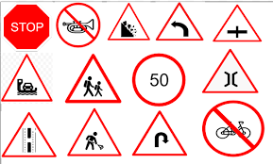
Introduction :
Traffic signs are an essential part of our day to day lives. They contain critical info that ensures the safety to all the people around us.
Without traffic signs,all the drivers would be clueless about what might be ahead to them and roads can become a mess.
In order to avoid this mess we have come up with the idea of “Traffic Sign Recognition”

Slide 4
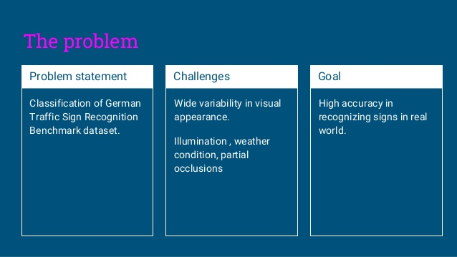
Objective :

Slide 5
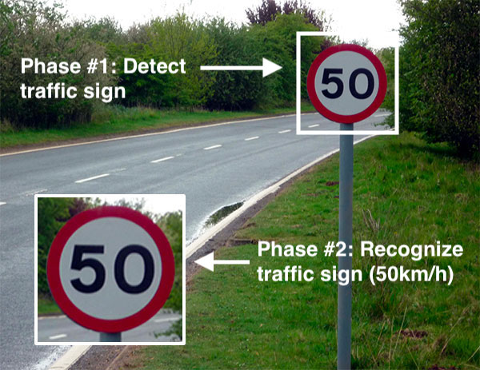
About the project :
Every country has some standards set for the design of different traffic signs like U-turn, Left-turn, Right-turn, No-entry, etc. Traffic-sign recognition (TSR) is a technology by which a vehicle is able to recognize the traffic signs put on the road e.g. "speed limit" or "children" or "turn ahead"
The earlier Computer Vision techniques required lots of hard work in data processing and it took a lot of time to manually extract the features of the image.
Now, deep learning techniques have come to the rescue and today we will see how to build a traffic recognition system.

Slide 6
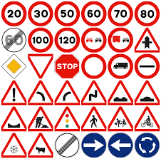
Dataset :
GTSRB (German traffic sign recognition benchmark) which is almost same as INDIAN TRAFFIC SIGNS.
It contains :
Train folder - images in 43 different classes having over 12,000 images for testing purposes.
Test folder - has test images for testing

Slide 7
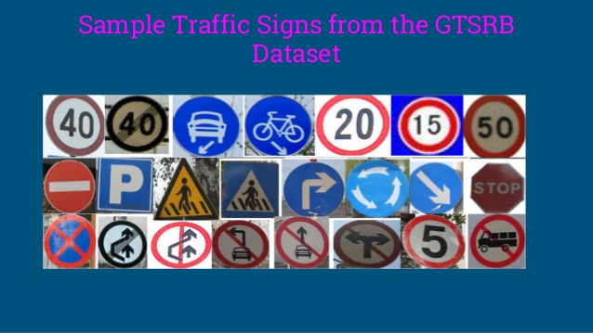

Slide 8
Prerequisites :
To implement this project we will be using-
Tensorflow
Keras which is a popular deep learning framework for python and some additional library
Scikit-learn
Matplotlib
Numpy
PIL for image processing
Pandas
CV2
pycharm

Slide 9

Steps to build the project:
Setup the project.
Import the necessary libraries and initialize variables.
Load the dataset
Split it into test, train such that test part contains a ratio of .2% of data.

Slide 10
Applying categorical function to get fixed values
Applying sequential model
First layer is a 2d convolution layer which has 32 filters and relu as activation function
Next layer is a maxpool layer with pool size of (2,2) and a dropout of .25% is added
Next two layer are 2d convolution layer which has 64 filters and relu as activation function
Next layer is a maxpool layer with pool size of (2,2) and a dropout of .25% is added

Slide 11
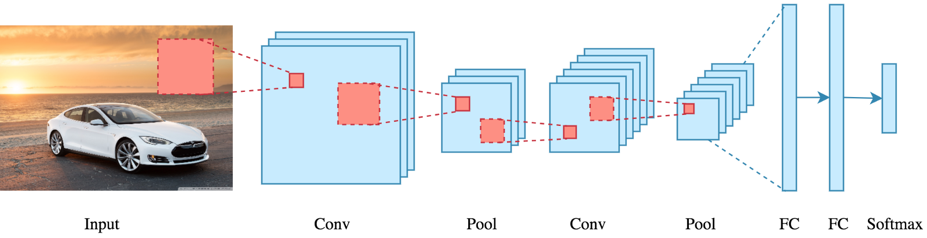

Finally 2 dense layers are applied one with relu activation and other with softmax.
Then the model is made to fit with 25 epochs.
At this stage we will ge a loss of 0.5 and accuracy of 0.9250 on training data and validation loss of 0.307 and validation accuracy of .9534

Slide 12
GUI Construction:
Importing the model
Declare a dictionary to store the names of all the symbols.
Use cv2.VideoCapture for capturing live images.
We are using infinite while loop to capture video elements.
After capturing image some preprocessing is done and then the sign is predicted.

Slide 13
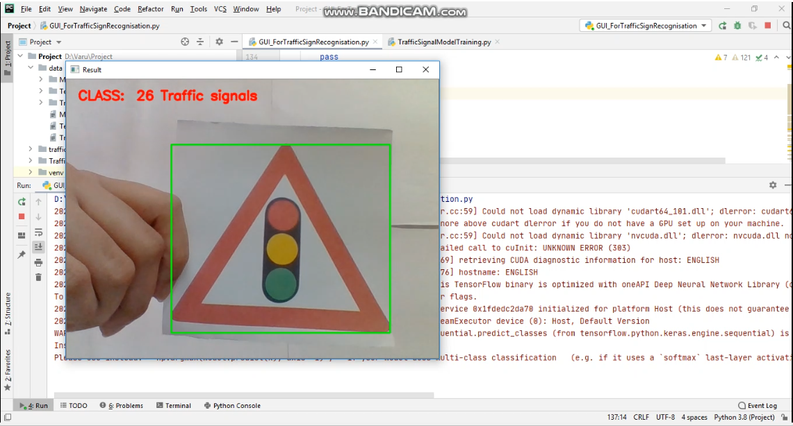
Output:

Slide 14
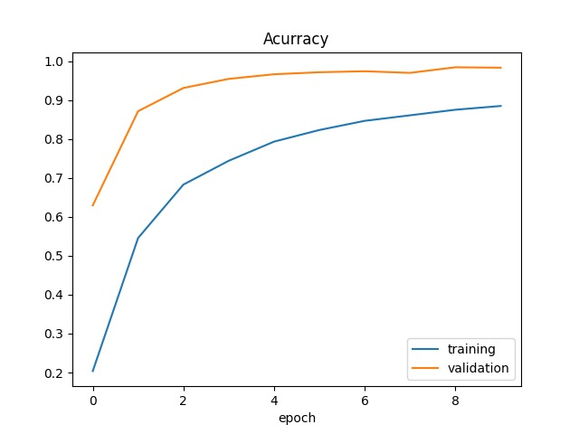
Accuracy:
Training accuracy is 90%
Validation accuracy is 95%

Slide 15
Thank You

